Slide 1

VitalFlow Guardian Data-Powered Cardiac Risk Management
"Prevention is the best cure for any disease." - Hippocrates

Slide 2
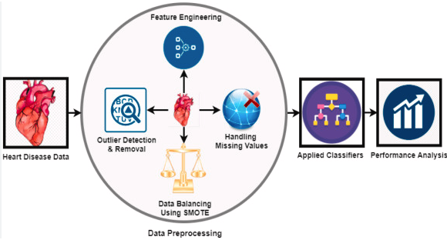
Introduction
Problem Statement
Dataset Information
Feature Overview
Data Cleaning
Exploratory Data Analysis
Model Selection and Evaluation
Results
Conclusion and Recommendation
References

Slide 3

Introduction
Cardiovascular diseases claim approximately 17 million lives annually worldwide, primarily due to events like heart attacks and heart failures.
Heart failure (HF) is a significant concern, characterized by the heart's struggle to pump enough blood.
In the United States, heart disease remains a leading cause of death, necessitating a comprehensive understanding of its multifaceted nature and underlying contributing factors.
"VitalFlow Guardian" is a dedicated initiative focused on developing predictive models for cardiac risk management through meticulous data analysis and advanced machine learning techniques.

Slide 4

Problem Statement
Heart failure poses a significant global health burden, contributing to millions of deaths annually.
Accurately predicting heart failure risk factors remains a challenge despite medical advancements.
Project aims to identify pivotal risk factors contributing to heart failure through comprehensive data analysis.
Evaluation of diverse machine learning models to predict heart failure outcomes.
Ethical considerations integral to uncovering insights while ensuring patient privacy and data security.
Objectives include improving prediction accuracy, enabling early detection, and facilitating personalized interventions in practical healthcare settings.

Slide 5

Dataset Information
Source: Centers for Disease Control and Prevention (CDC) via Kaggle
Dataset Size: 319,795 rows, 18 columns
Target Variable: "Heart Disease" (Coronary Heart Disease or Myocardial Infarction)
It stands out for its comprehensive coverage, amalgamating five distinct heart-related datasets and encompassing crucial attributes like age, gender, chest pain type, blood pressure, and cholesterol levels
The dataset is clean, with no null values, and most columns exhibit binary values of Yes and No. However, the heart disease column demonstrates significant class imbalance, with strategies like oversampling used to address it

Slide 6


Feature Overview
Categorical Features
---------------------------
Heart Disease
Smoking
Alcohol Drinking
Stroke
Difficulty Walking
Sex
Race
Diabetic
Physical Activity
General Health
Asthma
Kidney Disease
Skin Cancer
Continuous Feature
---------------------------
BMI (Body Mass Index)
Physical Health
Mental Health
Age Category
Sleep Time

Slide 7


Data Cleaning
Binary Categorical Variables Encoding
Multiclass Categorical Variables Handling
Balancing the Dataset
Scaling Continuous Features
Integer Encoding for Categorical Variables, those having 2 unique values
Dummy variable for Categorical variables having more than 2 unique values

Slide 8
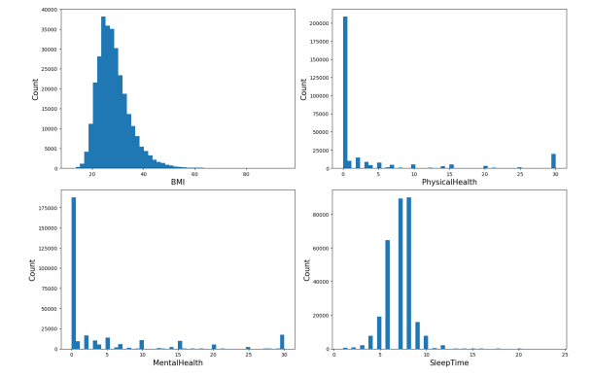
Exploratory Data Analysis
Histograms of the numerical features
The visualizations reveal that the heart disease dataset portrays overall good health, characterized by a predominant presence of individuals with a BMI within the normal range.
Additionally, both Physical and Mental Health scores are clustered around the mean, indicating a relatively balanced distribution.
However, the distribution of Sleep Time exhibits a right-skewed pattern, suggesting that a majority of individuals in the dataset sleep for less than 7.5 hours per night, with a median Sleep Time below this threshold
Contd…

Slide 9
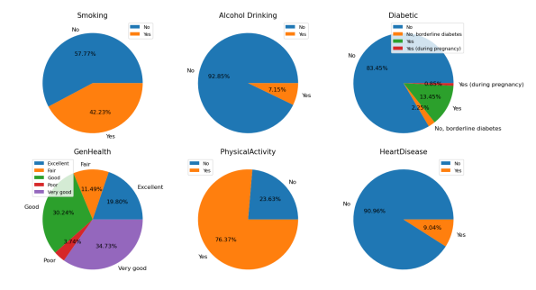
Exploratory Data Analysis
Pie graphs of the categorical features to analyze the data distribution
The heart disease dataset predominantly comprises individuals with commendable health habits, including abstaining from smoking, occasional alcohol consumption, and regular exercise.
Nonetheless, a minority exhibits less favorable health behaviors, such as habitual smoking, excessive alcohol intake, and a lack of physical activity.
Encouragingly, adopting healthier lifestyles, characterized by avoiding these detrimental habits, can significantly reduce the risk of heart disease among individuals
Contd…

Slide 10
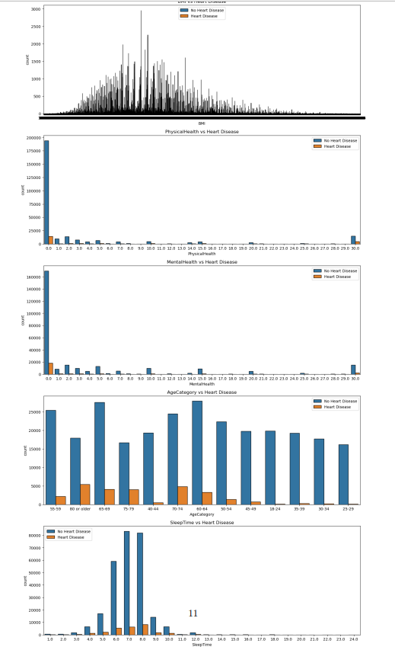
Exploratory Data Analysis
Numerical Features vs Target Variable (Heart Disease)
These observations indicate that specific risk factors are more prevalent among individuals with heart disease, including being female, reporting fair or poor general health, and belonging to an older age category.
However, it’s essential to recognize that these trends represent general patterns, and there are instances where individuals with heart disease may not align with these characteristics

Slide 11

Model Selection & Evaluation
Employed a diverse array of machine learning models including Logistic Regression, Decision Trees, Random Forest, XGBoost, and Gradient Boosting Machine (GBM) for cardiac risk management.
Thorough evaluation strategy integrates standard performance metrics like accuracy, precision, recall, F1-score, and ROC AUC, providing nuanced insights into model predictive capabilities.
Confusion matrices are utilized to visually represent true positives, true negatives, false positives, and false negatives, offering profound insights into model prediction mechanisms.
Models undergo rigorous assessment methodologies including cross-validation techniques and model-specific evaluations to ensure robustness and accuracy.
The multifaceted evaluation approach aims to provide accurate and actionable insights for enhancing heart health outcomes, facilitating informed decision-making in cardiac risk management.

Slide 12
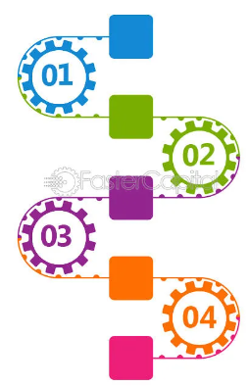
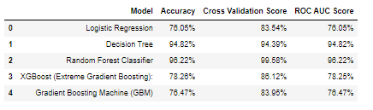
Results
Partitioned the dataset into training and test subsets with meticulous balance to maintain consistent class distribution of heart disease and non-heart disease cases.
The training dataset comprised 70% of the total data, with balanced representation of heart disease and non-heart disease cases.
Evaluated the performance of five machine learning models for heart disease prediction, with the Random Forest Classifier achieving exceptional accuracy of 96.21% on the test dataset.
The Random Forest Classifier demonstrated high precision scores for both heart disease and non-heart disease cases, highlighting its capability to differentiate between the two classes accurately.
Identified key features for predicting heart disease, including BMI, Age Category, Sleep Time, Physical Health, and Mental Health, based on feature importance values obtained from the model.

Slide 13

Conclusion and Recommendation
The Random Forest Classifier has demonstrated exceptional predictive power with a 96.21% accuracy rate, underscoring its significance in detecting potential heart disease cases.
Recommendations include expanding the dataset to encompass a broader range of health records, collaborating with healthcare institutions for data acquisition, and conducting feature engineering to identify influential variables contributing to heart disease.
Model maintenance is crucial for long-term performance, necessitating regular updates and retraining to adapt to evolving trends and data patterns in heart disease research.
Collaboration with medical professionals and experts is advised to refine the model and align it with current clinical standards, facilitating the development of a tool that offers valuable insights for early intervention and tailored treatment strategies.
Implementing these recommendations can enhance the capabilities of the Random Forest Classifier, contributing to more precise and proactive healthcare interventions in the battle against heart disease.

Slide 14

References
1. https://www.kaggle.com/datasets/kamilpytlak/personal-key-indicators-of-heart-disease
2. https://www.kaggle.com/code/andls555/heart-disease-prediction
3. https://www.kaggle.com/datasets/fedesoriano/heart-failure-prediction
4. https://archive.ics.uci.edu/dataset/45/heart+disease
5. https://towardsdatascience.com/heart-disease-uci-diagnosis-prediction-b1943ee835a7
6. https://www.analyticsvidhya.com/blog/2022/03/logistic-regression-on-uci-dataset/
7. https://www.sciencedirect.com/science/article/abs/pii/S0010482521004662
8. https://www.ndc.scot.nhs.uk/docs/Heart%20Failure%20Dataset.pdf
9. https://www.sciencedirect.com/science/article/pii/S2001037016300460
10. https://www.nhlbi.nih.gov/research/heart-failure
11. https://www.ahajournals.org/doi/full/10.1161/CIRCRESAHA.121.318172
12. https://www.kaggle.com/datasets/fedesoriano/heart-failure-prediction

Slide 15

Thank You
Debabrata Mishra
Bellevue University
DSC630 - Predictive Analytics

